Slide 1

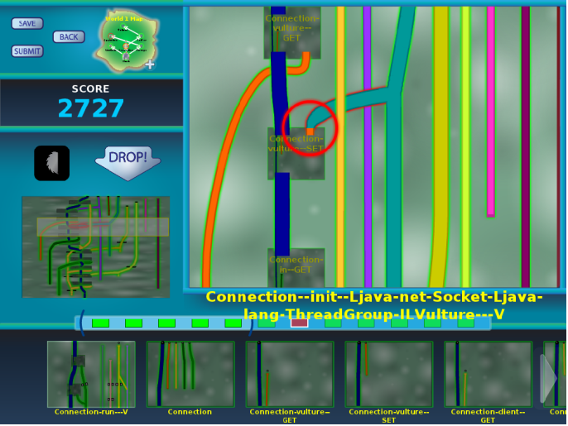
Verification games: Making verification fun
University of Washington
http://cs.washington.edu/verigames
Jonathan Burke, Matthew Burns, Seth Cooper, Werner Dietl, Stephanie Dietzel, Michael Ernst, Nat Mote, Tim Pavlik, Zoran Popović, Tyler Rigsby, Eric Spishak, Brian Walker

Slide 2
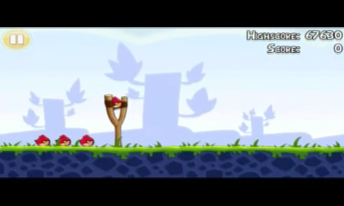
Angry Birds

Slide 3
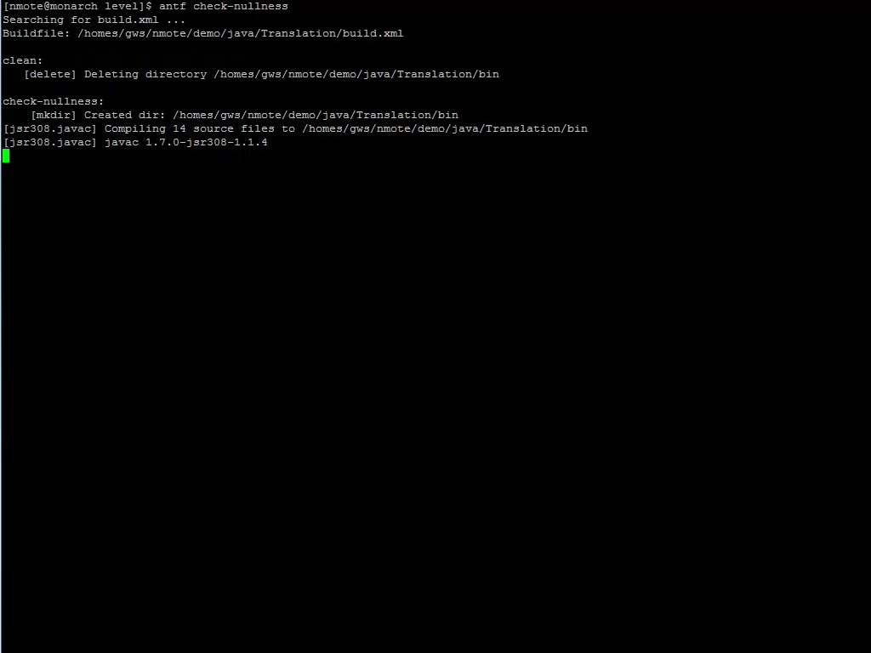
Software verification

Slide 4
Which is more fun?
Play games
Prove your program correct

Slide 5


Crowd-sourced software verification
Goal: Verify software while you wait for the bus
Make software verification easy and fun
Make the game accessible to everyone
Harness the power of the crowd

Slide 6
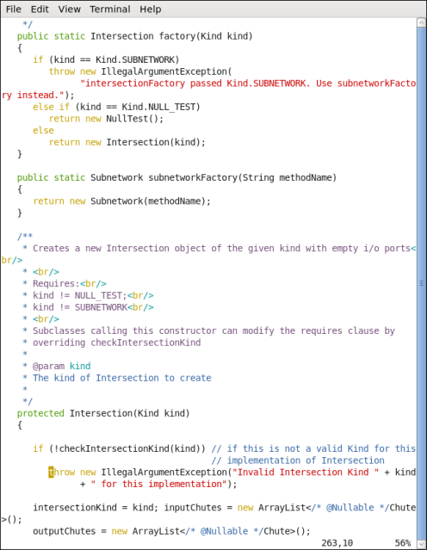
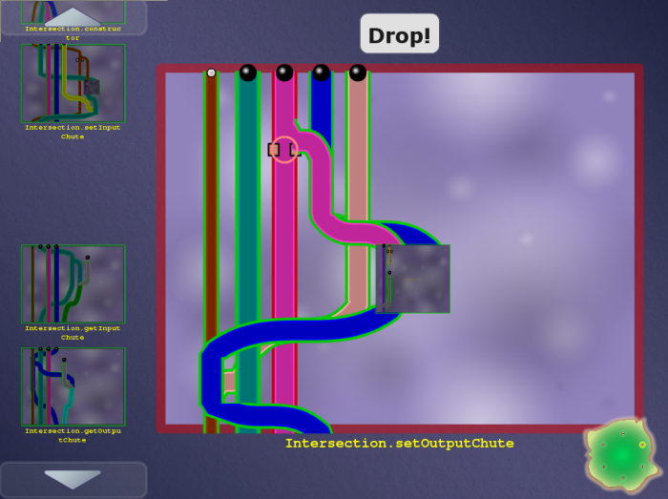
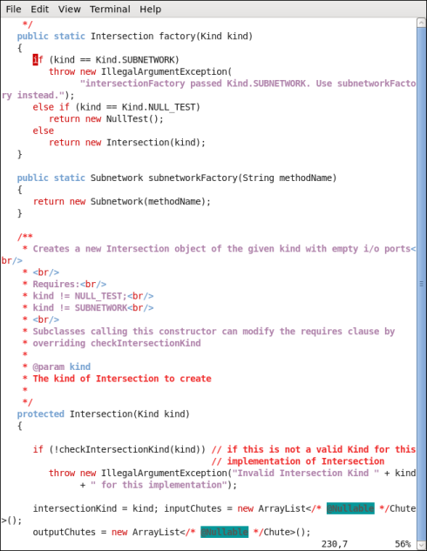
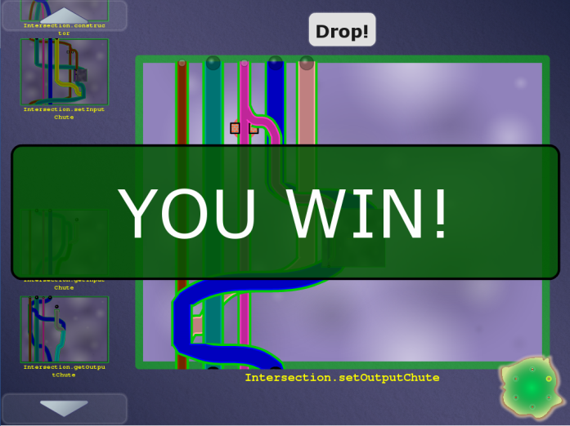

Code
Game
Automatic translation
Encodes a constraint system
Encodes a constraint system
Free labor
Highly-skilled, expensive labor
Verified software
(with proof/ annotations)
Completed game
Automatic translation

Slide 7
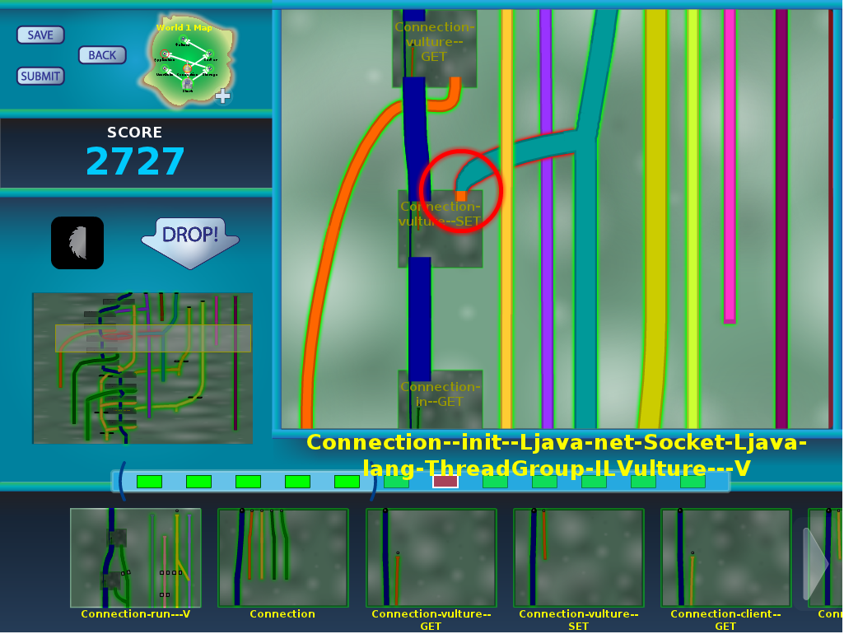
Pipe Jam game demo
Notes:
In the order: wind, earth, crash.

Slide 8
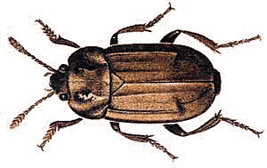

Code
Game
Automatic translation
Free labor
Highly-skilled, expensive labor
Bug detected, notify programmer
Completed game
with buzzsaws
Automatic translation

Slide 9



Program ↔ game correspondence
Intuition: dataflow
Pipe ↔ a variable
Pipe width ↔ a property of the variable (type)
Ball ↔ a value
Ball size ↔ a property of the value
Pinch point ↔ requirement
Unmodifiable pipe/ball ↔ requirement

Slide 10
Example: encryption
Goal: no cleartext is sent over the network
Pipe ↔ a variable
Pipe width ↔ narrow: encrypted, wide: cleartext
Ball ↔ a value
Ball size ↔ small: encrypted, large: cleartext
Pinch point ↔ network communication
Unmodifiable pipe/ball ↔ cleartext from user

Slide 11
Example: null pointer errors
Goal: no dereference of null
Pipe ↔ a variable
Pipe width ↔ narrow: non-null, wide: maybe null
Ball ↔ a value
Ball size ↔ small: non-null, large: null
Pinch point ↔ dereference
Unmodifiable pipe/ball ↔ literal null

Slide 12
Type flow vs. dataflow
Multiple flows per variable
A variable’s type may have multiple qualifiers
@Immutable Map<@English String, @NonNegative Integer>
Some variables are not represented at all
primitives (int, …) when analyzing null pointer errors
No loops
If program is verifiable, solvable in polynomial time
Human leverage: high-level pattern matching
More accurate intuition: type constraints
Building a new type inference framework

Slide 13
Other examples
SQL injection
unintended side effects
format string and regexp validation
incorrect equality checks
race conditions and deadlocks
units of measurement
aliasing
CWE/SANS Top 25 Most Dangerous Software Errors
…

Slide 14
What verification challenges?
Type system approach
Modular; local reasoning & understanding
Equally powerful as any other verification technology (theorem proving, model checking, …)
Less effective for correctness of numerical computations
Not good for full functional correctness
Not good for temporal properties (focus on data)

Slide 15
Challenges
Yes!
Can we build the system?
End-to-end: game ↔ program verification
Will the game be fun?
Better than waiting for the bus
Do people outperform verification algorithms?
Inference is undecidable (human experts ≫ algorithms)
Hypothesis: no for correct, verifiable programs,
yes for incorrect or unverifiable programs
Location of buzzsaws is key to the whole approach
Game players only have to reduce overall verification cost, not fully verify the program
Also see FoldIt (protein folding)
Maybe

Slide 16
Scoring
Score is influenced by:
Collisions (verifiability)
Use of buzzsaws (trusted assumptions)
Pipe widths, distinguishing input and output pipes (re-usability of modules)
Score is a proxy for quality of verification result

Slide 17
Collaboration and competition
High-score boards
Collaborative teams solve challenges
Share scripts
Interaction: chats, forums, …

Slide 18
3-way collaboration: machines, players, verification experts
Machines: Automatic inference and optimizations
Brute force is not feasible for large programs
Error messages from type inference systems are poor
Players do work that automated tools cannot
Leave a few easy challenges to encourage players
Verification experts do work that players cannot
Classify un-verifiable code as safe or insecure

Slide 19
Scalability
Programs have natural modularity, created by the programmer
World = program
Level = class
Board = method
Crowdsourcing scalability:
Distribute games to humans
Angry Birds: 5 million hours of play time per day
Reconfigure games to adjust difficulty
Redundancy

Slide 20
Status
Prototype exists
Scales to small programs (hundreds of lines)
Players say it is “kind of fun”
Many challenges remain
Scale to larger programs
Create tests (example failures, or counterexamples)
Scale to multiple players (parallelism, social aspects)
Make the game more fun
… many others

Slide 21

Contributions
Gamification of program verification
Game corresponds to correctness condition
Game utilizes physical intuition
Game is playable by anyone
Game allows application of human insight
Goal: cheaper verification ⇒ more verification
http://cs.washington.edu/verigames
Play it now: http://games.cs.washington.edu/verigame/pipejam-20120709/

Slide 22
FoldIt
Proteomics game at UW
Effectively created the genre of games that solve hard problems
Three Nature papers in under 2 years
Over 240,000 players, 200+ new per day

Slide 23
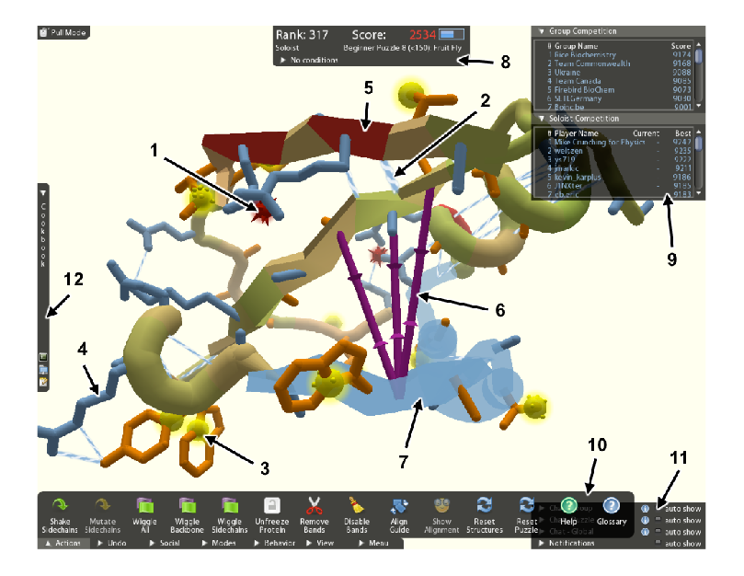
FoldIt

